Slide 1

Btech 451
Project in Information Technology
Mid-Year Seminar
Yijing Wei

Slide 2
Outline
Project Overview
Distributed Service Profiler
Research and Work So Far
Hibernate Testing Application
Demonstration
LoggerInterceptor
Future Work

Slide 3
Project Overview
- Distributed Service Profiler
Analyses calls and communications between various services
Displays information
Argument size
Return size
Time taken
Number of hits

Slide 4
Project Overview
- Distributed Service Profiler
The Problem
The current profiler does not include displaying information of calls made by services to the database
The Goal
To extend the current Distributed Service Profiler
to integrate with the database layer
to intercept queries made to the database
and measure this information

Slide 5
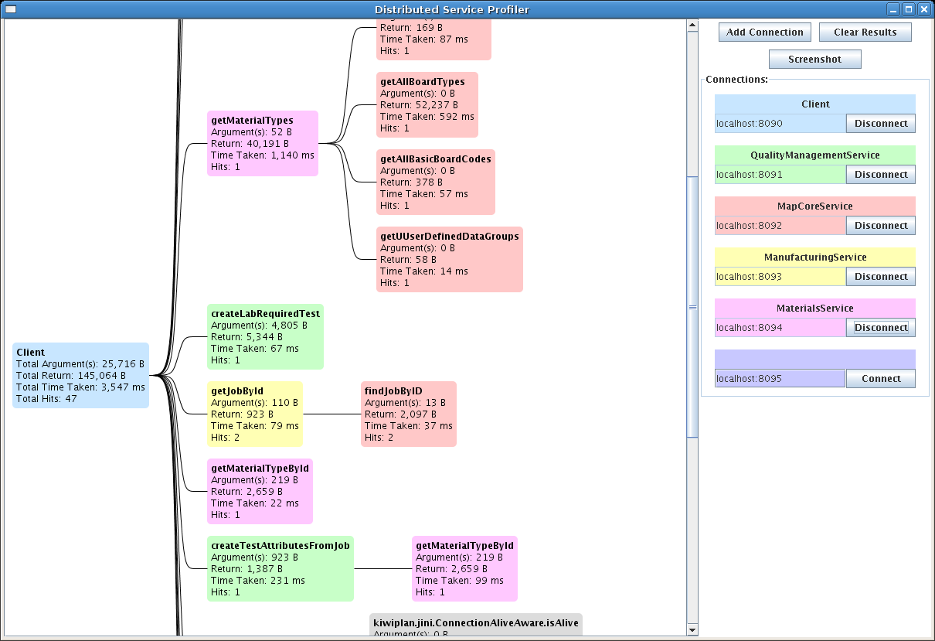
The interface

Slide 6
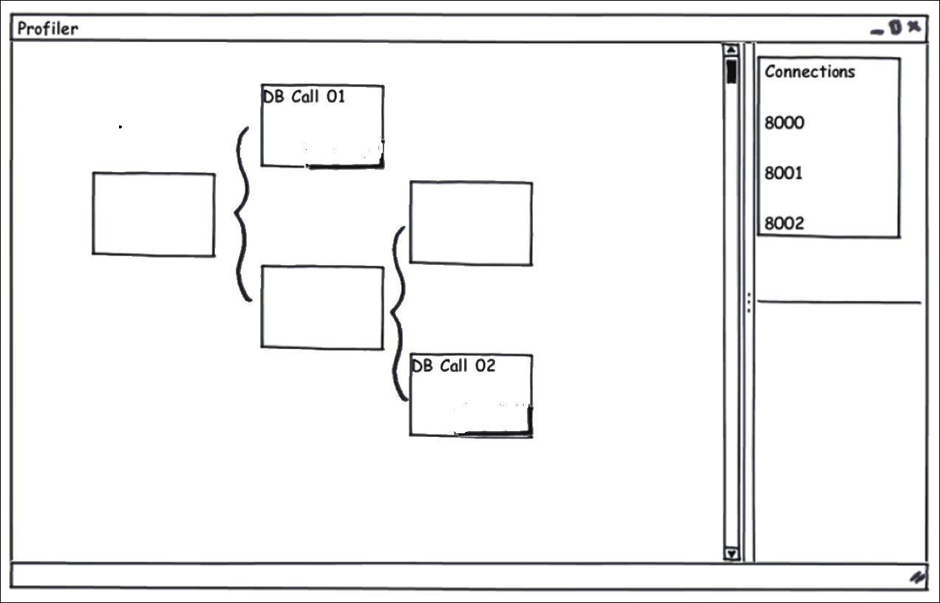
Mock - Up

Slide 7
Work So Far
Looking into the source code of the profiler
Research into Hibernate Interceptor
Empty Interceptor
Hibernate Testing Application
Implemented the LoggerInterceptor

Slide 8
Hibernate Interceptor
A Java interface which can be configured with an application and a database to intercept queries made to the database by that application
Will be invoked every time a select, update, insert or delete query is made to the database
Implement EmptyInterceptor

Slide 9

Empty Interceptor
Methods that I will implement
onSave()
onDelete()
onLoad()
onFlushDirty()
afterTransactionBegin()
afterTransactionCompletion()
Saved
Deleted
Initialized
Updated

Slide 10
Demonstration
An interceptor which extends the EmptyInterceptor – MyInterceptor.java
A table in the database – EMPLOYEE table
A Java Employee class – Employee.java
A mapping file which maps the Java Employee class to the EMPLOYEE table in the database – Employee.hbm.xml
A Hibernate configuration file – hibernate.cfg.xml

Slide 11

Logger Interceptor
Very similar to MyInterceptor.java
Implements the same methods as in MyInterceptor
Needs to be integrated with the profiler

Slide 12
Future Work
Integrating the LoggerInterceptor with Distributed Service Profiler
Extracting the argument bytes and return bytes from queries
Matching queries with their callers
Stack trace
Thread.currentThread().getStackTrace()
Creating and displaying the query node
Research on profilers for distributed systems

Slide 13
Questions?

